Slide 1
Welcome To My Presentation
Md. Sabuj Mia
Roll: 25
Batch: 46

Slide 2
My Topic Name:-
Citizen Trust on Rural Government Delivery Service in Bangladesh

Slide 3
To find out the level of citizens’ trust in the service delivery of rural government based on the provisions of the citizen charter.
Project Objectives
The main objectives of the project paper are:
To explore the behaviour that impedes and expedites the level of citizens trust in the in the service delivery of Union Parishad in rural government

Slide 4


Rural area in Bangladesh

Slide 5
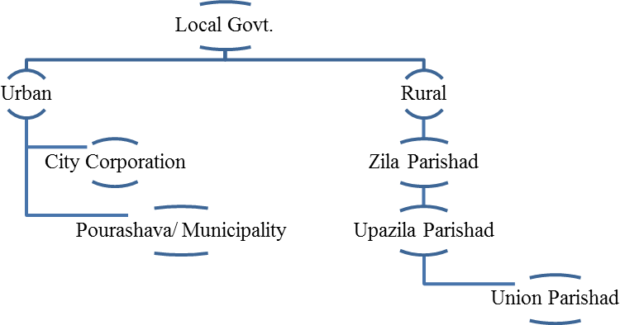
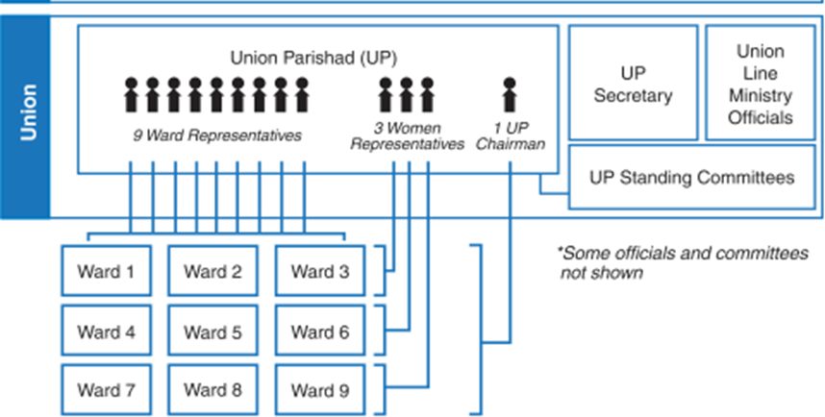
Structure of Local Government
Structure of Union Parishad

Slide 6
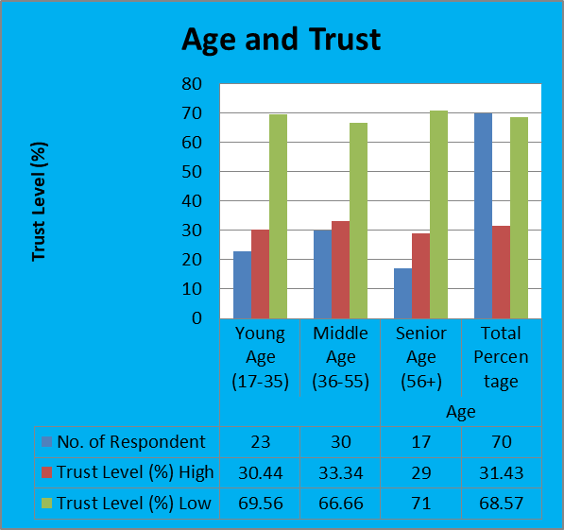
Overall Trust on Union Parishad

Slide 7
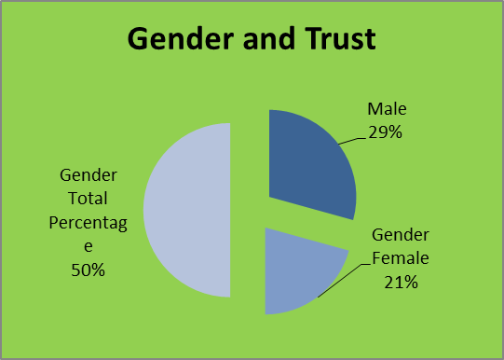
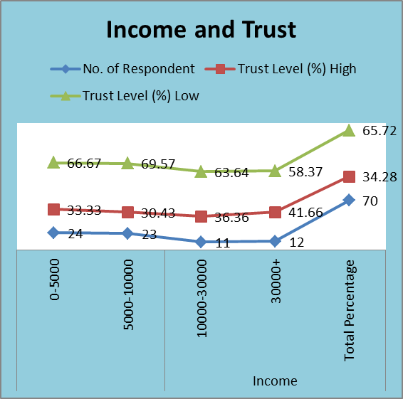
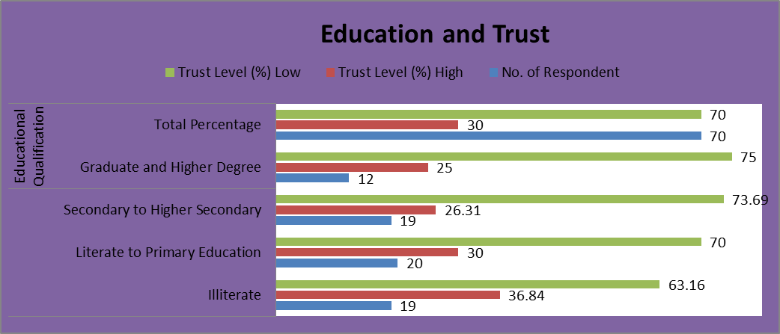

Slide 8
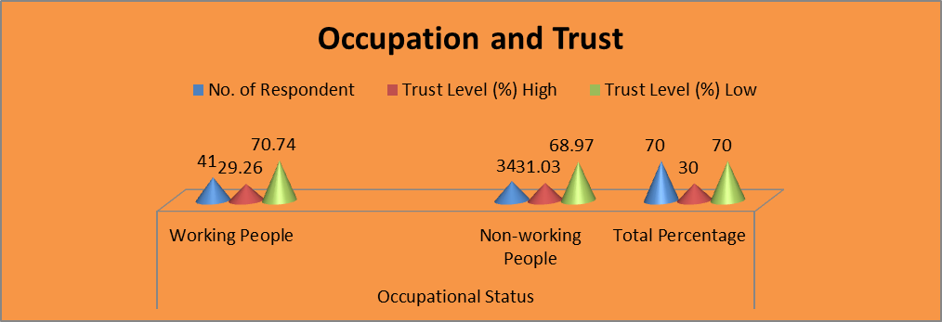
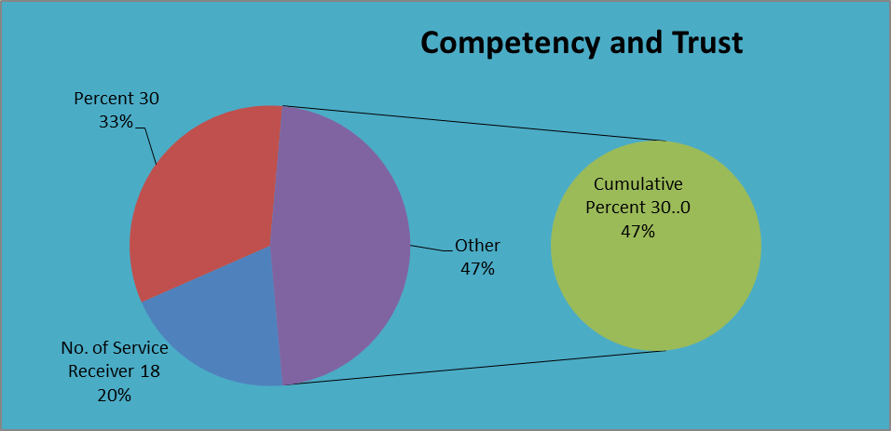

Slide 9
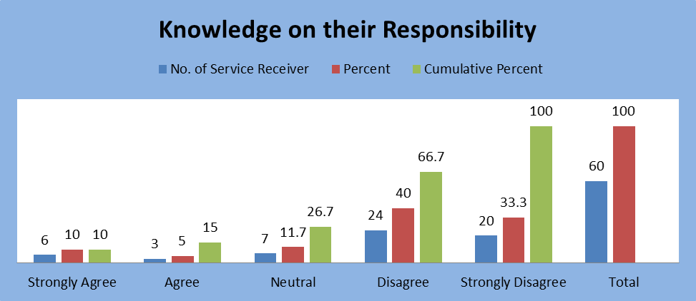
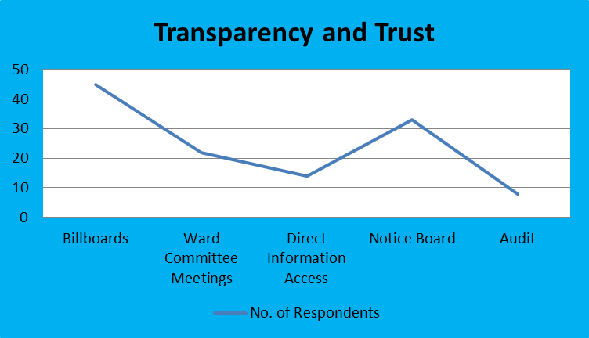

Slide 10
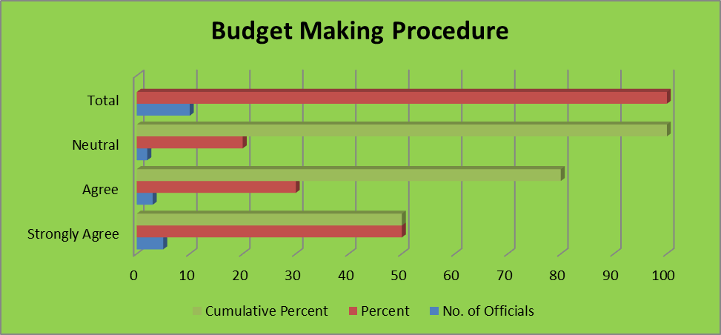
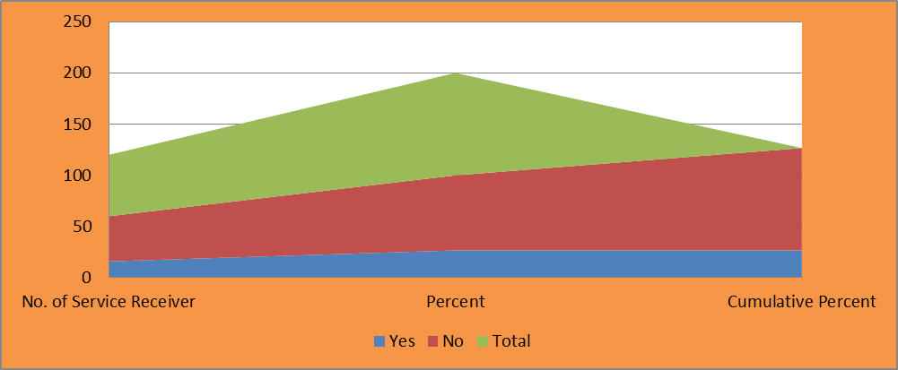

Slide 11
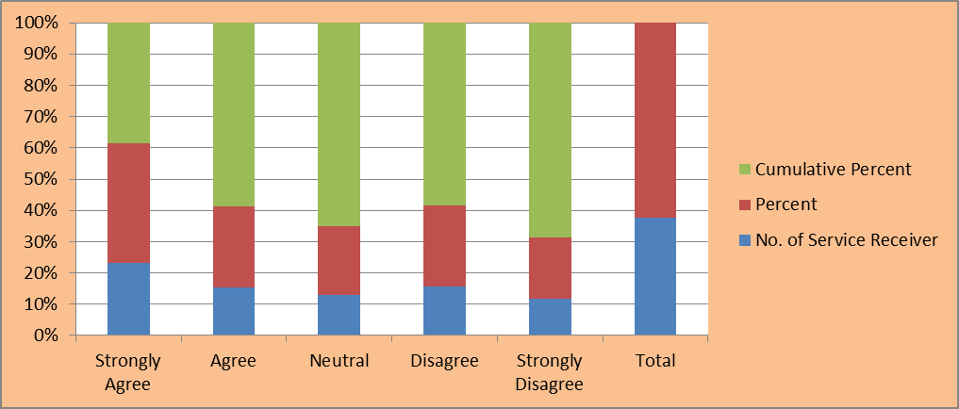
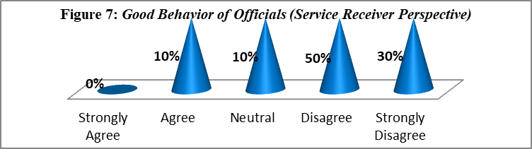

Slide 12
Findings and Conclusion
This study is based on one Union Parishad under Shariatpur District. Citizens' trust in Union Parishad is low. Citizens generally have a negative perception of Union Parishad officials. Citizens have some negative experiences with LGI operators. People's perception that Union municipalities are not efficient in service delivery. 86.7% of the service recipients agreed that top officials are not skilled enough to perform their duties properly. Most of the time they were not professional and their behavior was not good. 73.3% of the respondents did not agree that civil servants' knowledge of their duties is minimal. They were in a hurry to achieve their interests.

Slide 13
Thanks To All

